Slide 1
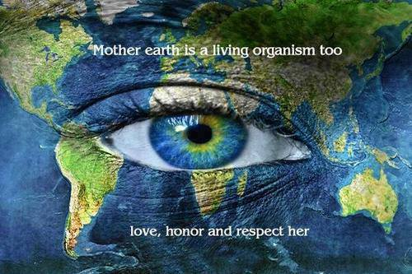
Glocal Climate Workshop Garba Diallo, Crossing Borders 2022 Crossing Borders 2022 02/12/2022 Garba Diallo

Slide 2
Key reflection points
What is the problem humanity is facing
What are the roots of the problem
What are the consequences
The good news
The council of all beings

Slide 3
The problem
Humans behave as if we are not part of nature, but apart from and above it
The pyramid view of the universe according to which the few are on the top of the many
The animal farm structure of society in which all humans are equal, but some are more equal than the rest

Slide 4
The roots of the problem
https://www.youtube.com/watch?v=yV2EK2bMgwk
Industrial growth society according to which the world comprises separate and competitive parts based on zero sum game
There is not enough for human greed
The resources of the earth are limited
Enough doesn’t exist when it comes to money
Our capacity to exploit the earth resources is getting more destructive

Slide 5
Why is the growth collapsing ?
Needs are over met in many countries
More difficult to increase productivity
Increasing raw material prices hinders growth
Environmental degradation undermines the growth

Slide 6
Jørgen Ørstrøm Møller:
The economic model with endless growth does no longer work
We are moving from mass consumption to economic scarsity
We are moving toward knowledge economy, sharing economy, voluntary economy – which the computer models cannot handle

Slide 7
Signs of climate change

Slide 8
https://climate.nasa.gov/evidence/

Slide 10
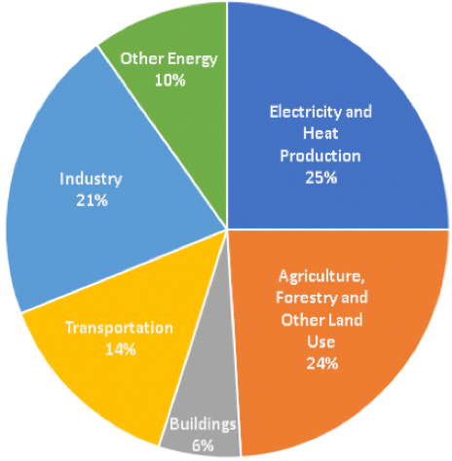
The causes of Climate Change Global greenhouse gas emissions by country and economic sector
According to IPCC, it is highly likely that human activity is responsible for the warming through greenhouse gases especially carbon dioxide, methane and ozone, amongst others

Slide 11
Climate justice, rich nations contribute with 70% of C02

Slide 12
http://www.ecoequity.org

Slide 13
The new climate movements

Slide 14
Why are people protesting from Algeria, Chile, India, Iraq to Lebanon to Sudan

Slide 15
Greta effect

Slide 16
Enough is becoming enough
Climate strike
Climate grief
Flight shame
Extinction rebellion
Greta effect
Climate roar (brøøøl)

Slide 17
Climate Justice

Slide 18
The good news
The information, knowledge and technologies that optimize carbon-free economy is already available
The climate challenges can be a solution to cross-cutting global problems: employment, clean cities, democracy, healthy life, peace….
The global transition movement toward more sustainable life is one of the fastest growing in the world
The great turning point is gaining momentum
Energy floors:
http://vimeo.com/58465094
https://vimeo.com/54513228

Slide 19
The way forward: Elinor Ostrom Polycentric approach

Slide 20
The first transition town: Totnes 2006

Slide 21
The transition now is spreading

Slide 22
Globally there are more than 1.100 cities and projects

Slide 23
The reconnection
From land to city
From soil to table
From head to hand
From consumption to community

Slide 24
Vision of
A new economy where:
- everything last longer and is used more efficiently
ressource consumption and environmental foot prints are reduced
- dependency on money and globalised economy are reduced
- equality among people increases
- new communities, new energy, new insights, new education for new values are generated

Slide 25
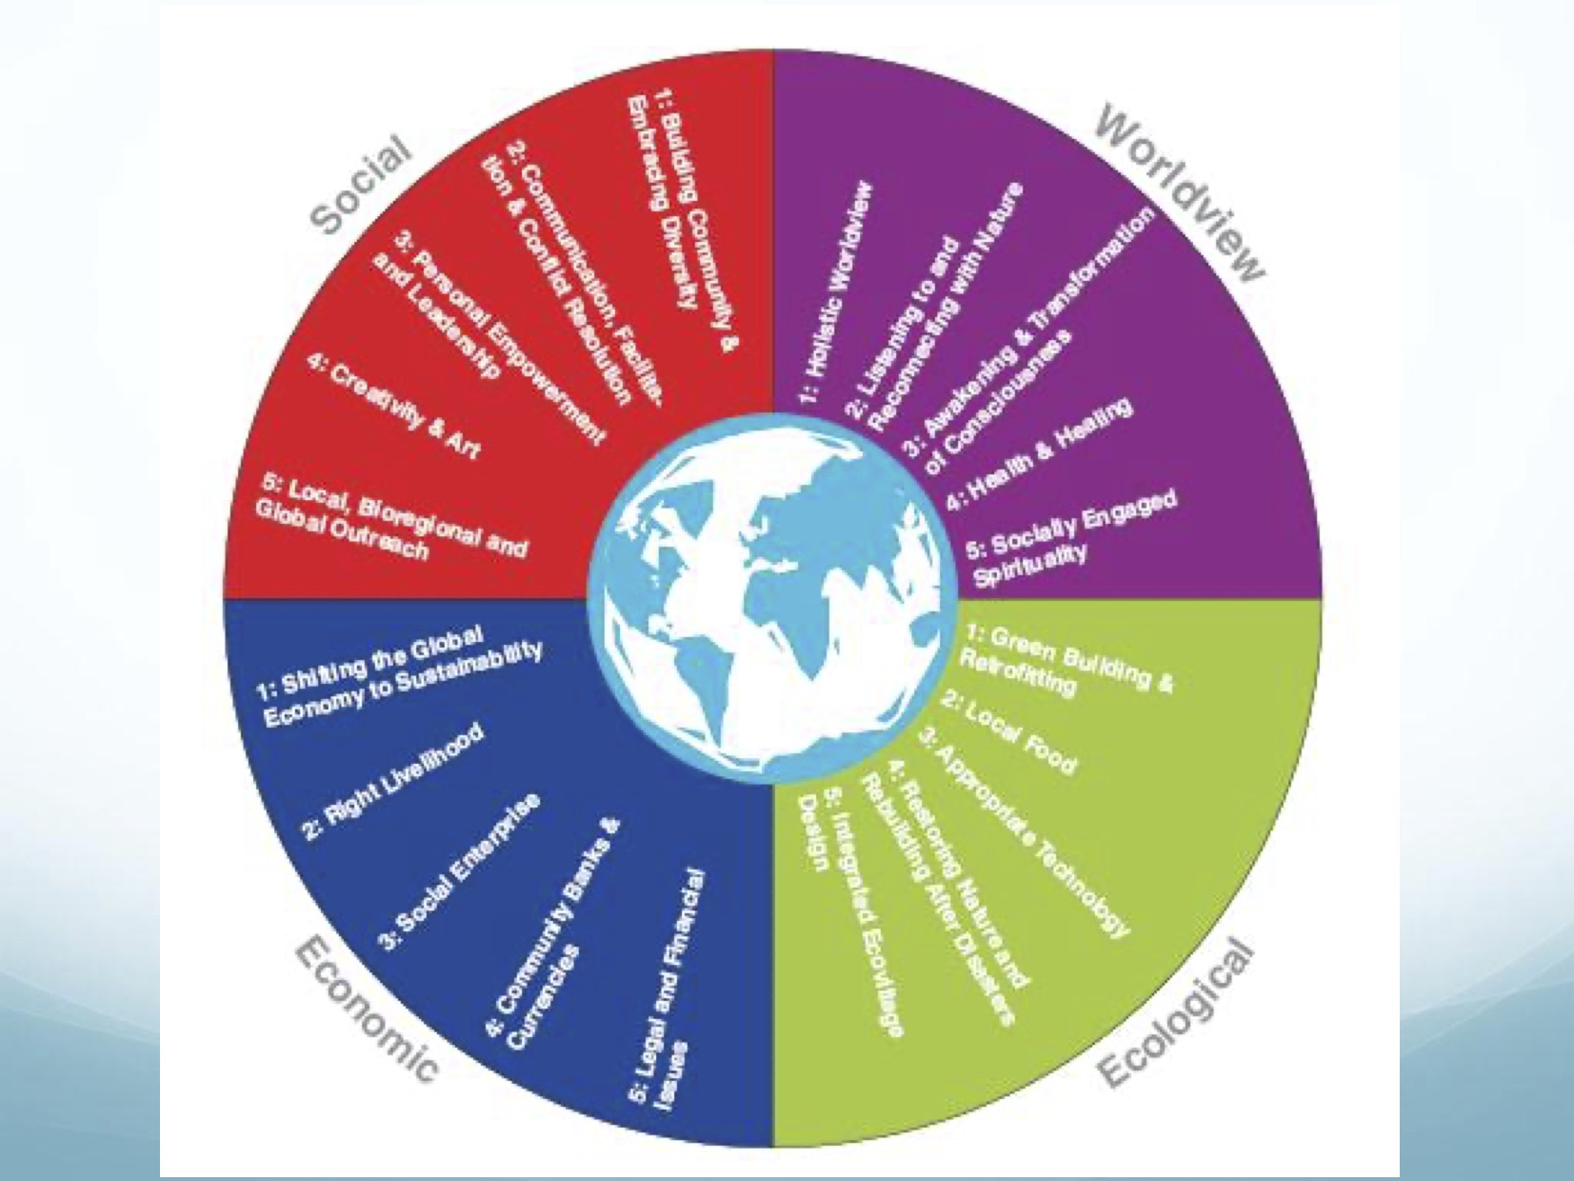

Slide 26
The great turning point by Joanna Macy:
https://www.youtube.com/watch?v=LwlXTAT8rLk

Slide 27
Thank you for your attention :-)

