Slide 1
TOOLKIT SWEDEN

Slide 2
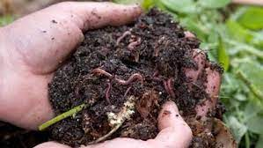
The magic box
This experiment may take up to one month to complete. The aim is to show in practice what happens when litter is thrown out in nature as well as the benefit of using any kind of compost device.
Material needed:
A box with soil
A worm
A watercan
3 flower sticks
6 pieces of paper
Colouring pens
A slice of bread
Boiled pasta
A whole boiled egg with the shell still on
A folded plastic bag
A piece of aluminium formed into a ball
A paper cup cake form
Start with placing a layer of soil at the bottom of the box. Put down the six last items mentioned above. Cover with soil and put down the worm. Water regularly. Divide the flowersticks and draw the objects you have put down on small pieces of paper that are attached to the sticks in order to remember where each item was put down. Water regularly and wait for a month.
Discuss with students what they think will have happened?
Have the items disappeared or are they still there?
Discuss why.
What is the role of the worm?
What is sustainable development?

Slide 3
Climate impact
- Car
Which model and fuel are used?
- Heating
Which source of heating is used and what is the environmental cost?
- Transports
When are different members of the family in need of the car?
What other options do they have?
- Water consumption
What does the consumption of water look like for different members of the family?
- Food
How do the families reason when it comes to food, snacks and candy buying?
- Clothes
What are the families´ ideas about clothes? How much do they spend?
- Vacation
Where do they go and how do they get there?
- Household litter
How is it taken care of?
- Electronical devices
How do they use them? Where do they end up?
- Electrical lightning
Which kind of lightning do they use and in what way?
Group work: Create the environmental habits of two different families. Start by inventing the members of the two following families.
The healthy family whose motto is “Save the Planet”
The non-environmental friendly family whose motto is ”We don´t care”.
Let the families follow their motto to the fullest in the life choices they make. Write a story about each family where the topics below are included.
Discuss afterwards in groups how their choices affect the climate. Don´t forget to motivate the choices you make for the different families and add a reference list.

Slide 4
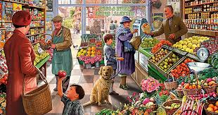
In the supermarket
Goal: To raise awareness about the environmental impact of importing groceries
Instructions: Buy groceries to cover all the meals during one week for the whole family, consisting only of groceries that are domestic (produced in your own country).
Will you be able to find all the groceries needed for all meals?
What will the difference in quality be?
What will the difference in price be?
If you don´t find all the groceries needed, is it possible to find good alternatives, that also are domestic?
I you were to only buy domestic groceries, would you consider changing your meal habits?

Slide 5
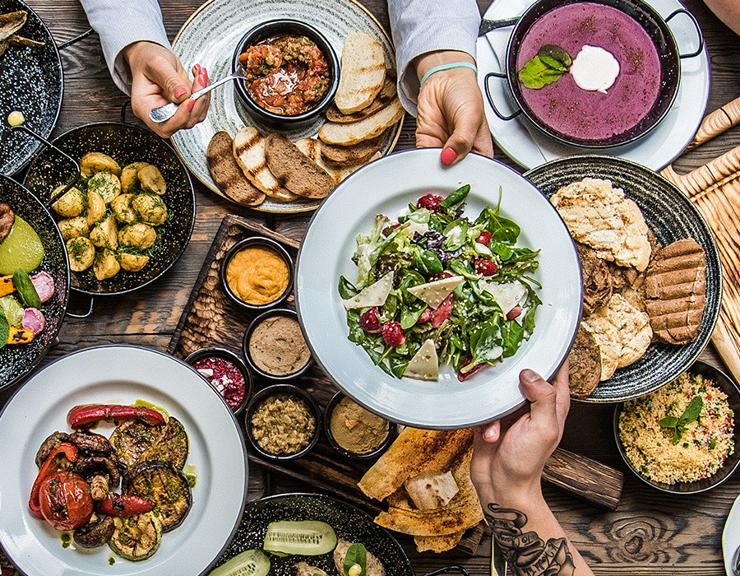
My Best Meal
You return home with your best friend and plan to make dinner together. Use your knowledge about how to achieve the global goals when you compose a the meal. Take the following into consideration:
Taste
Nutrition and energy contents
Production and transport conditions
Economy
Work in pairs and make an oral presentation where you can motivate your choices from an environmental point of view.

Slide 6
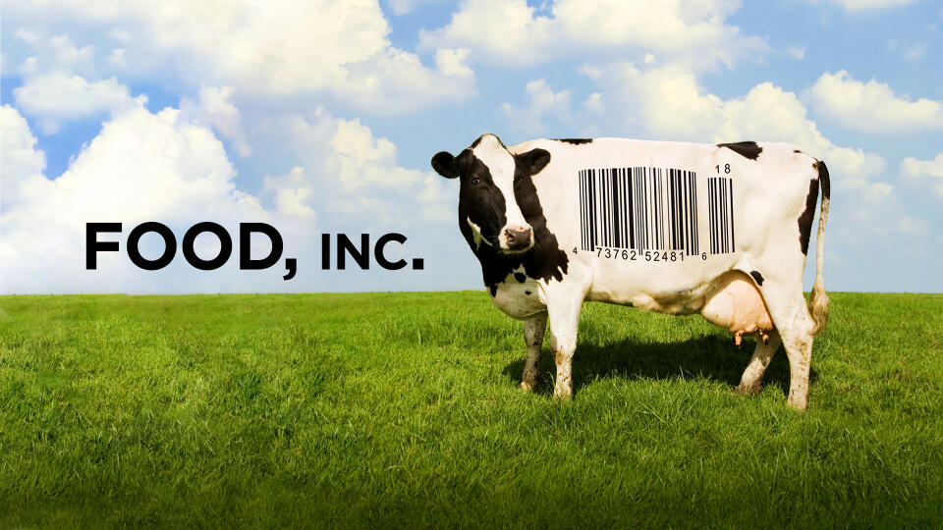
Exercise: FOOD INC
Watch the film called ”FOOD INC” which is about the mass production of meat in the food industry and the consequences it has.
Discuss the contents of the film in small groups.
Analyze the table of contents of a frozen meal. Look for any eco-labeling on the package?
Choose a home-made recipe for the same meal as the frozen one and compare the contents and the price for the ingredients.
Present the two different meals and motivate which meal is the best one out of an environmental point of view.

